Slide 1
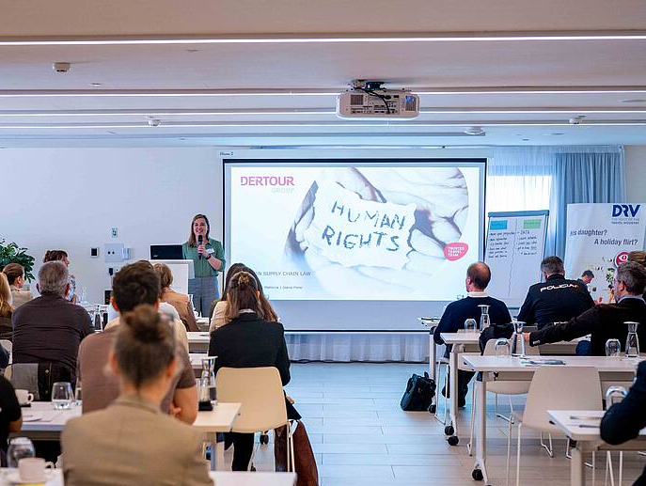

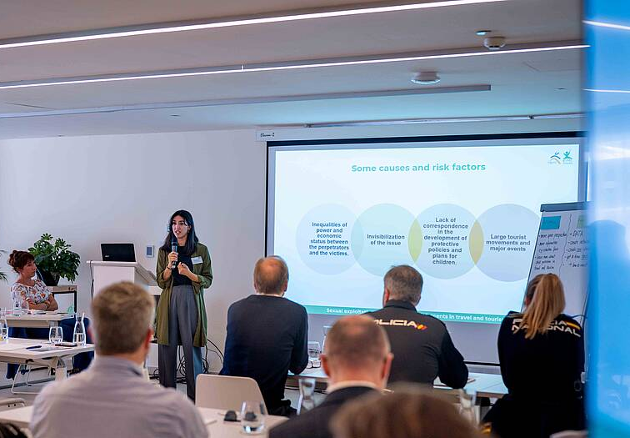


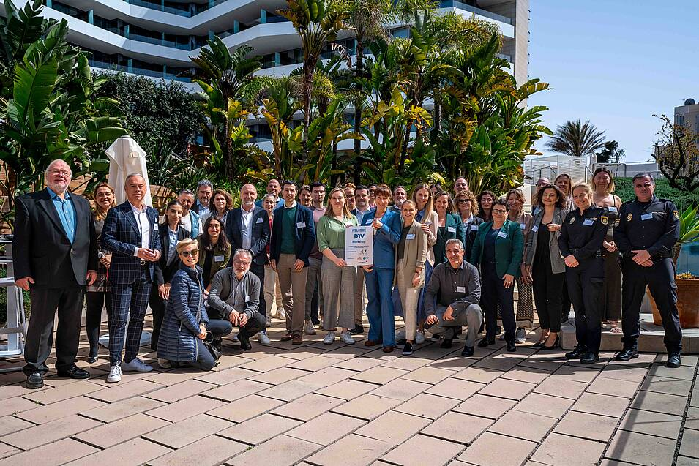

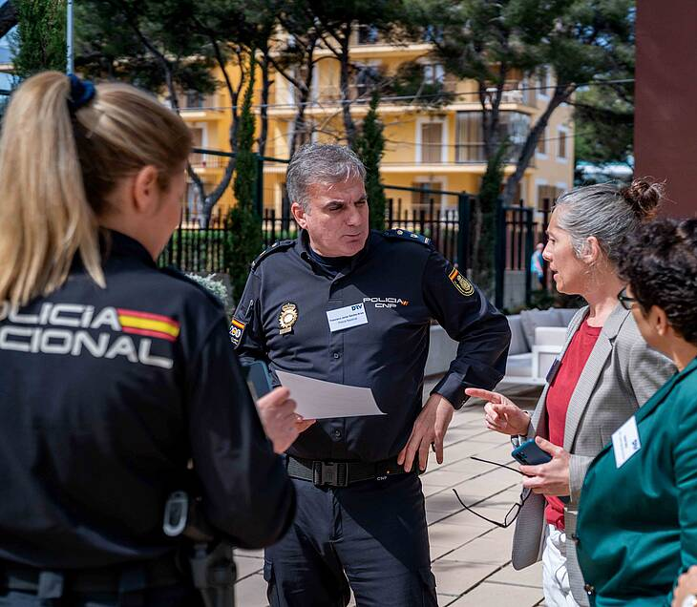


Child safeguarding
Destination workshop on Mallorca was a success and raised awareness on Child Safeguarding within sector
Destination workshop 19.03.24 on Mallorca at Hotel Iberostar Llaüt Palace, together with DRV
Goal: Raising awareness and collaboration for Child Safeguarding among relevant stakeholders in tourism
Helpful insights and practical recommendations for action from external trainer, the NGO ECPAT, companies and the Spanish police
More than 50 participants: Mallorcan Hotels, DMC, Transportation companies, Police and further local stakeholders
The workshop was evaluated very positively among the participants
Notes:
Uli Sperl war auch dabei → Vielen Dank für die Teilnahme und die gute Zusammenarbeit mit der DMC-Division

